Slide 1
node js

Slide 2
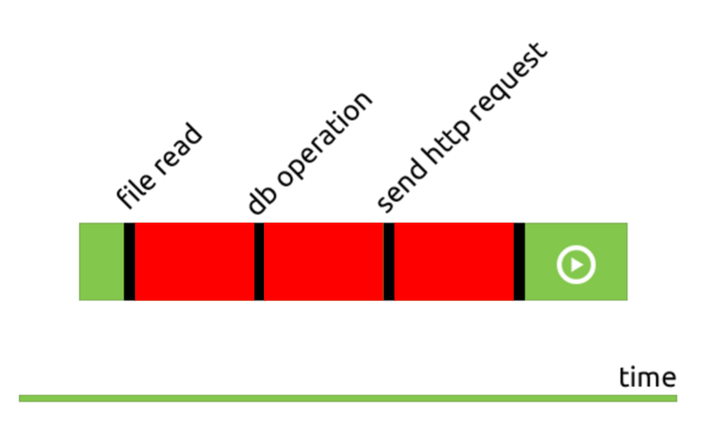
asynchronous

Slide 3

server

